Slide 1

Aerospace Angular Web Application
Owen Lindsey
Professor Sparks, James
Milestone 4
11/10/2024

Slide 2

Project Overview
Purpose: - Efficient management of aircraft maintenance data.
- Centralized system for tracking aircraft performance and maintenance history.
2. Key Features:
- Aircraft data management.
- Maintenance record tracking.
- Performance metric monitoring .
3. Main Endpoints:
- /aircraft: manage aircraft information.
- /maintenance: Handle maintenance records.
- /performance: Track performance metrics.
- /performance-analytics: Shows data in various charts.

Slide 3

Technical Stack
Category | Technologies | Description
Frameworks | Angular 17 – Frontend Express.js – Backend SQL Server - Db | Angular: Frontend framework for building web applications. - TypeScript: Superset of JavaScript for type-safe coding. - SQL Server: Relational database for storing application data.
UI Components | Angular Material | Provides ready-to-use, customizable UI components like tables, dialogs, and form fields for a modern, consistent look.
Form Handling | Reactive Forms FormBuilder | Reactive Forms: Provides powerful form validation and reactive programming capabilities for handling dynamic forms. FormBuilder: Simplifies form creation and management.
Charts & Visualization | Ngx-Charts | A library for creating customizable and interactive charts, useful for displaying performance metrics and analytics.
Other Tools | HttpClientModule RouterModule | HttpClientModule: Handles HTTP requests, used for API communication with Express backend. RouterModule: Manages navigation and routing in the Angular application.

Slide 4

Front End Component Structure
Component | Use
`performance-metrics` | Tracks key performance indicators. Displays all performance metrics for the specified aircraft. This page has a support page named performance-analytics. This page will allow you to create, read, update, and delete performance metrics. View analytics will take you to a page that will show the data in various charts.
`maintenance-history` | Displays all maintenance actions performed on the aircraft. This page allows you to filter data by maintenance category. You can also search the records for a keyword in the search filter. Create, read, update, and delete maintenance history is supported on this page.
`aircraft-list` | Displays all our aircraft in the inventory and a summary. Stores the model number, serial number, date of manufacture, flight time, etc. You can navigate to the performance records or maintenance history from here. Here users can create, read, update, and delete entire aircraft from their inventory.

Slide 5
Front End Component Structure
Component | Use
`dashboard` | Provides a simple summary of the user’s aircraft inventory. Displays a navigation menu for aircraft-list, maintenance-history, and performance-metrics. This page will allow you to quickly go to a specific aircraft’s maintenance-history or performance-metrics from the homepage.
`performance-analytics` | A line chart, bar chart, and a gauge each visually detail aircraft performance metrics.

Slide 6

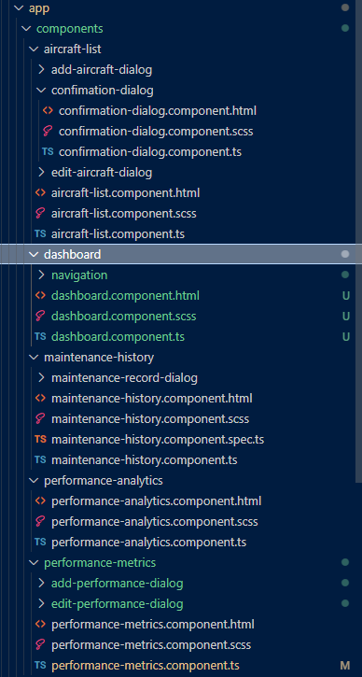
Support components
Component | Use
edit-aircraft | Allows user to update aircraft data.
add-aircraft | Allows user to add an aircraft to the inventory
add-maintenance | Allows user to add maintenance actions to the specified aircraft.
Add-performance | Allows user to add performance metrics to the specified aircraft.
Edit-performance | Allows user to update performance metrics to the specified aircraft.
Confirmation | Shared component that allows users to delete records.
navigation | Provides navigation cards to the dashboard.

Slide 7
Aircraft endpoints
Display | Endpoint | Purpose
Aircraft Fleet page | http://localhost:4200/aircraft/2/performance/analytics | Displays all aircraft data from `aircraft` table in our database.
Maintenance Records page | http://localhost:4200/aircraft/2/maintenance | Displays the maintenance history for aircraft 2 in a table.
Performance Metrics page | http://localhost:4200/aircraft/2/performance | Displays the performance data for aircraft 2 in a table.
Performance Analytics page | http://localhost:4200/aircraft/2/performance/analytics | Displays the performance analytics in various charts on this page.
Dashboard | http://localhost:4200/dashboard | Displays the various pages supported by our application with a quick summary of each page.

Slide 8
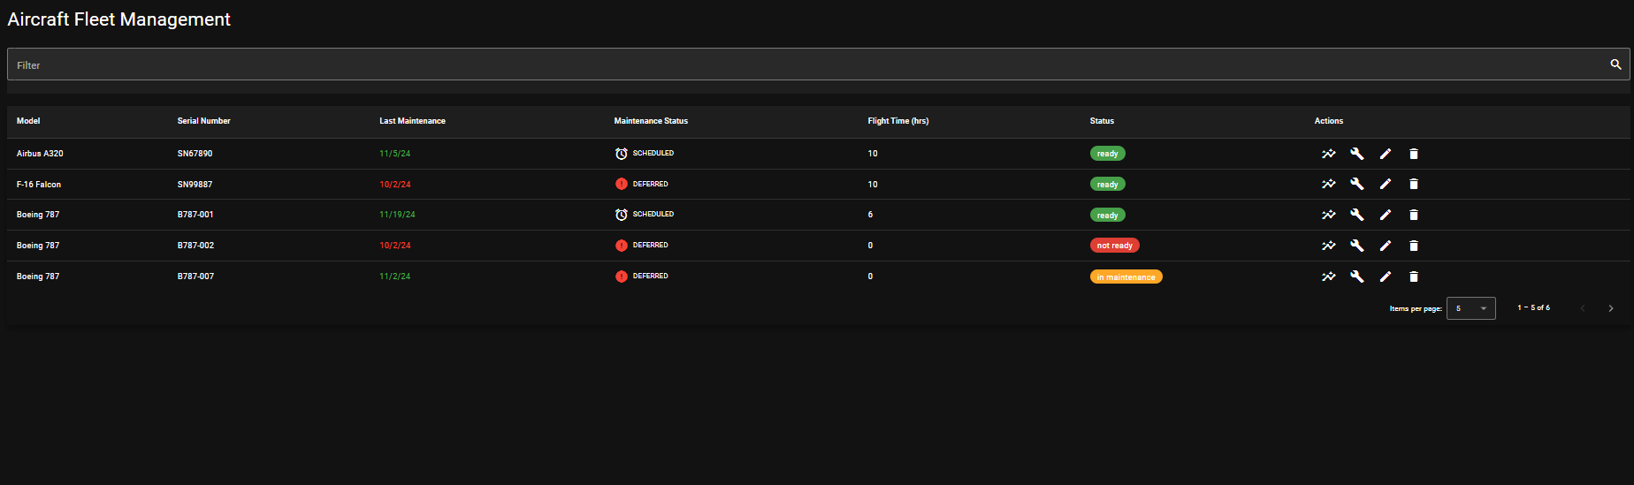
Aircraft-list Page

Slide 9
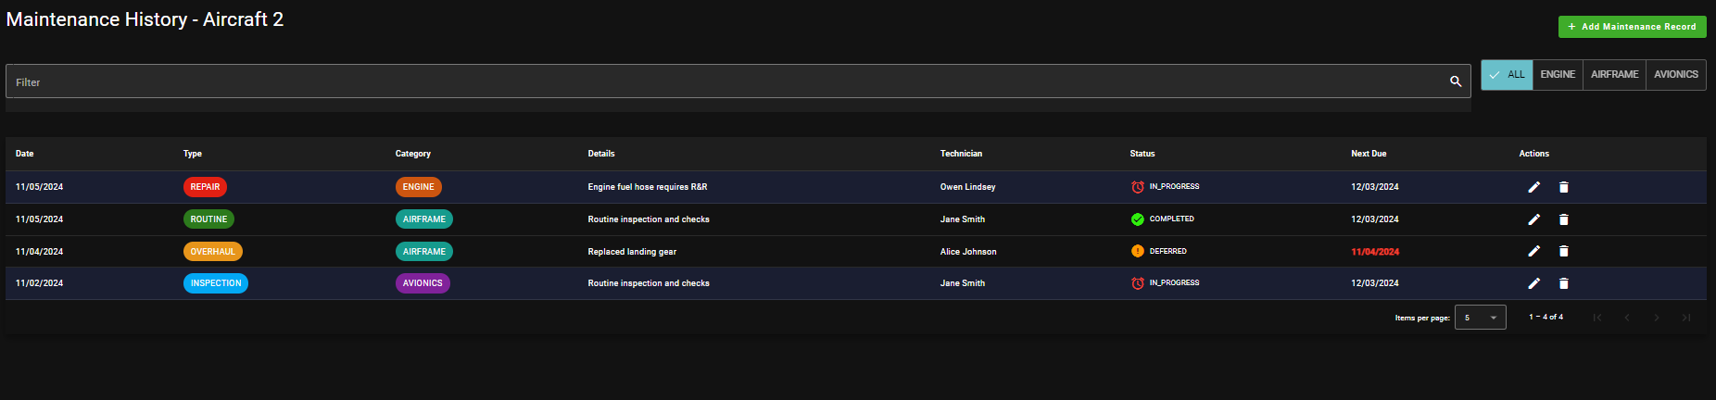
Maintenance-history Page

Slide 10
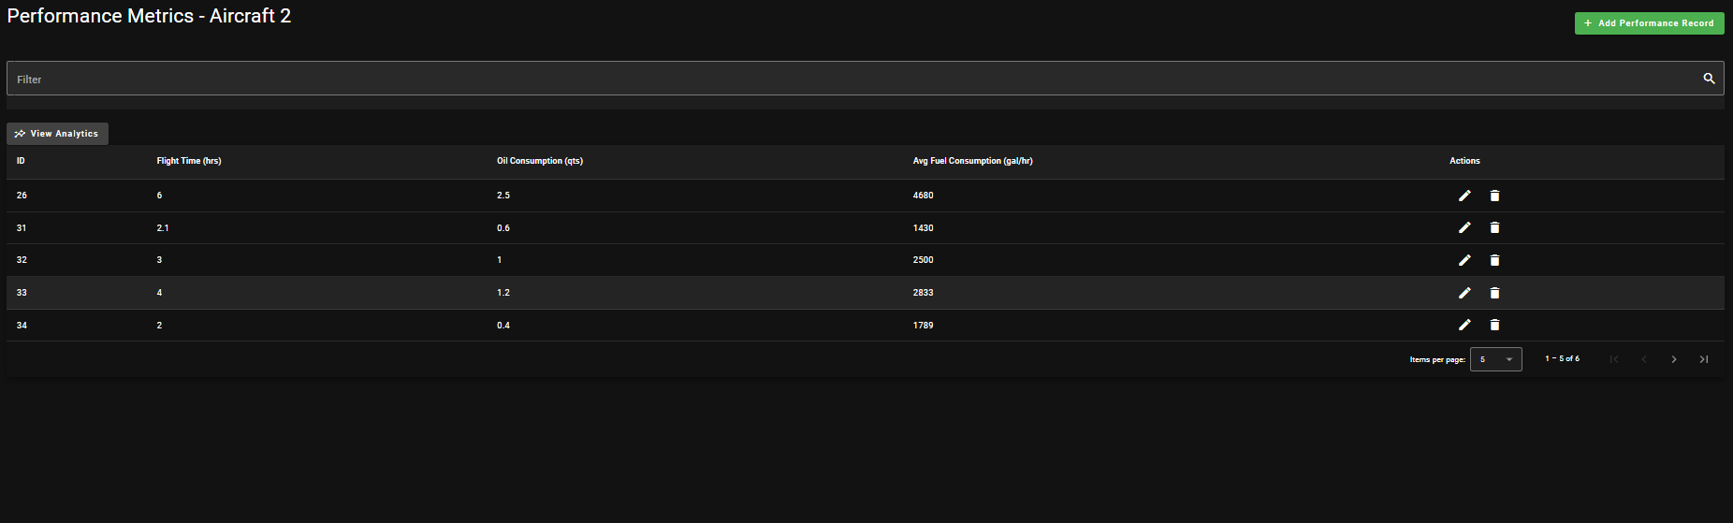
Performance-metrics Page

Slide 11
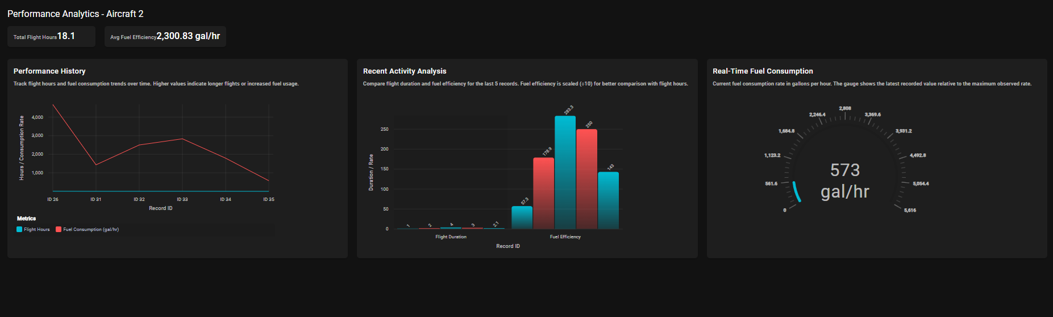
Performance-analytics Page

Slide 12
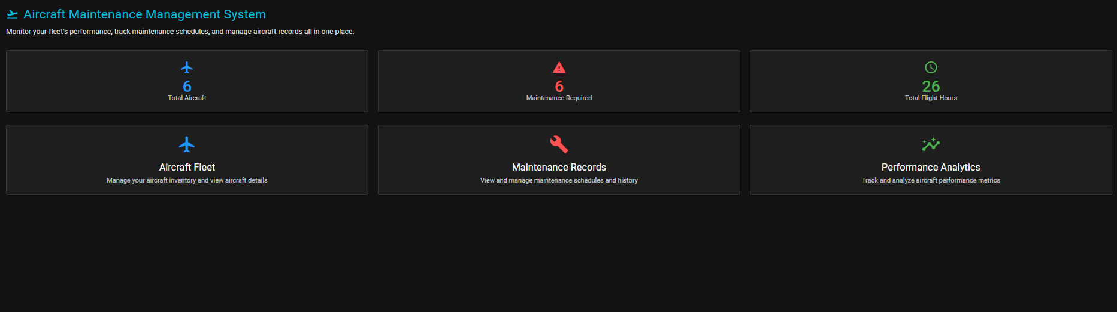
Dashboard Page

Slide 13
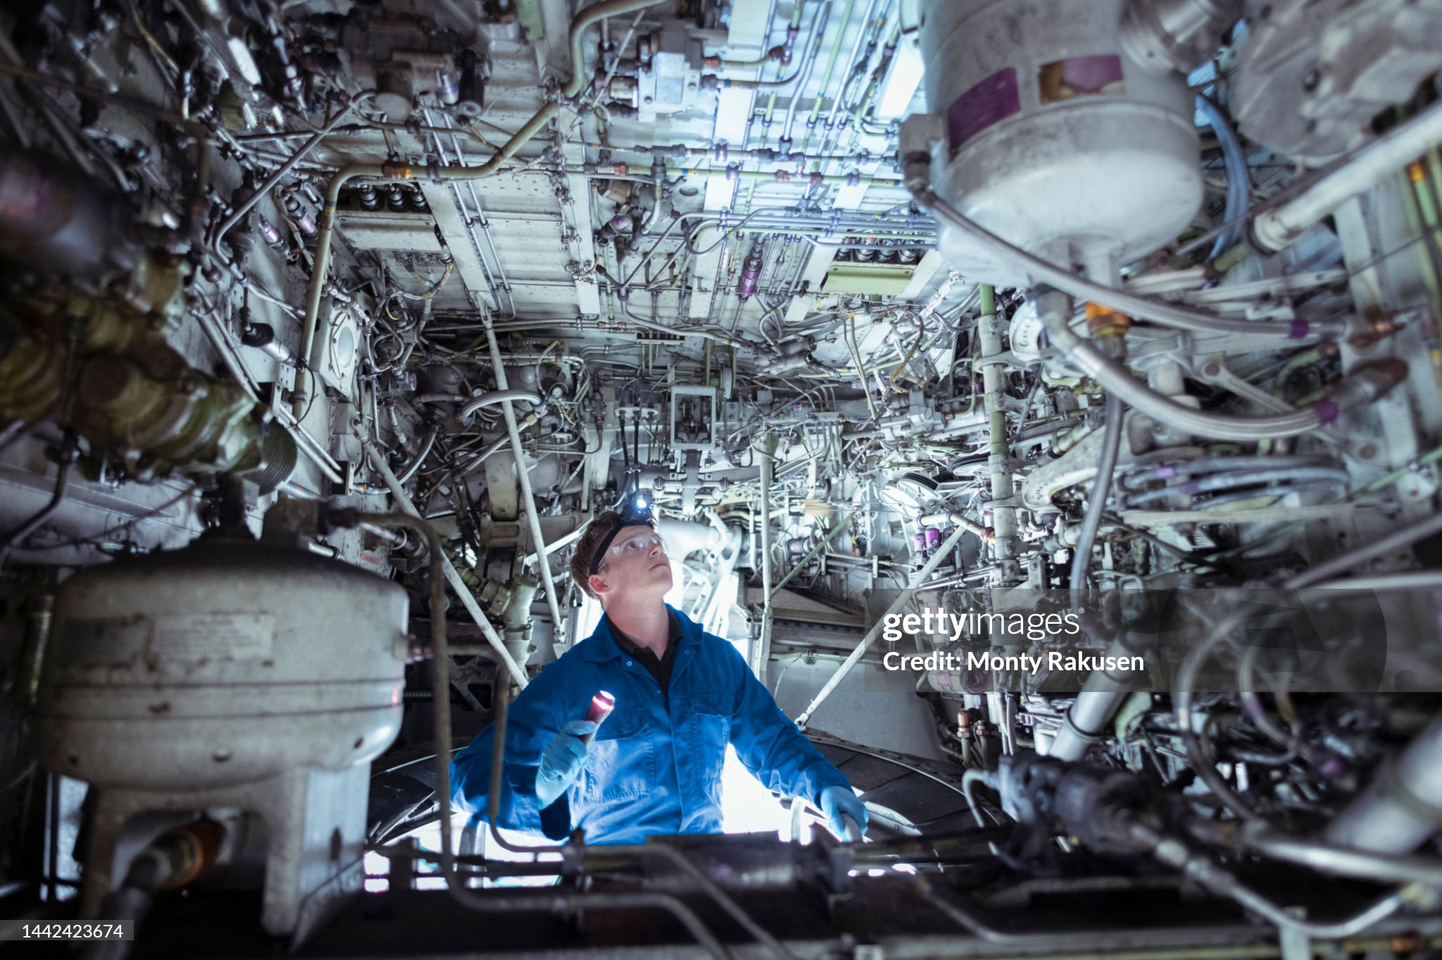
Challenges Encountered
Challenges | Reasoning | Example | solution
Data Consistency | Challenge: Ensuring that all related data remains consistent across different tables, especially when updating or deleting records. | Deleting an aircraft record without properly handling its related maintenance and performance records could lead to orphaned data or integrity issues. | Implementing cascading deletes in the database schema and careful transaction management in the API logic.
Date and Time handling | Managing and standardizing date and time data across different operations, especially considering potential timezone differences. | Storing maintenance dates in UTC but displaying them in local time, or handling date formats consistently between client requests and database storage. | Adopting a consistent date-time handling strategy, possibly using libraries like Moment.js, and clearly documenting date-time expectations in the API.
Error Handling and Input Validation | Implementing comprehensive error handling and input validation to ensure the API behaves predictably and provides useful feedback. | Dealing with various edge cases, such as invalid aircraft IDs, malformed date inputs, or attempting to create duplicate records. | Implementing middleware for input validation, creating custom error classes, and setting up global error handling to provide consistent, informative error responses across all endpoints.

Slide 14
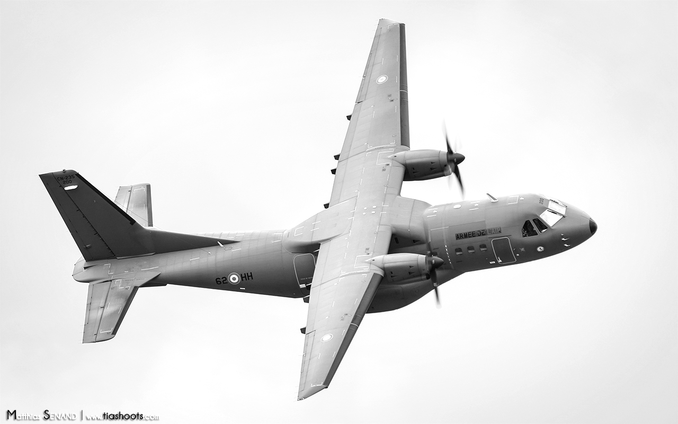
Pending bugs and current limitations
Current limitations | Future improvements
The web app is currently designed and tested only in a local environment, which may not reflect real-world environments. | Potentially Dockerize the application for easier deployment and scaling
The error handling could be more robust and informative. | Add HTTPS support for more secure communication in prod environment.
The web app has not been stress tested with large amounts of data or high simultaneous usage. | Possibly adding more features as time allows such as report generation and notification system for routine scheduled maintenance actions.

Slide 15

Lessons learned
Key take away | Explanation | Lesson
Importance of modular design | Sharing components when able is valuable. Modules allow components, directives, and services to be reused across different parts of my application. | design makes it easier to add or update features as the application grows. Each module can be developed independently and then integrated with the rest of the application, enabling better scalability.
Separation of concerns | Modules help keep related functionality organized by grouping components, services, and other resources together. This separation makes the codebase easier to navigate and maintain. | By having distinct modules, we can isolate and debug issues within a specific part of the application without affecting the entire system.
Efficient Loading | Angular supports lazy loading, where only the modules required at a given time are loaded. This can significantly reduce the initial load time of an application by deferring the loading of less critical modules. | By loading only what is necessary, modular design helps in optimizing performance, especially for large applications, by minimizing resource use.

Slide 16

Application to future web projects
Key take away | Lesson
UI with Angular Material | Knowledge of Angular Material for UI components supports quick prototyping, consistent design patterns, and responsive layouts in web apps
Data Visualization | Skills with data visualization libraries (NgxCharts) to present data insights effectively, useful for projects requiring dashboards and reporting features.
Cross-functional Development | Experience working with frontend (Angular) and backend (Express, SQL) fosters versatility for full-stack development roles and effective project collaboration.

Slide 17

Postman documentation
Postman document

Slide 18

Live demonstration
Live demo

Slide 19

Web application repo
Web application documentation repo

Slide 20
Questions?

